Slide 1
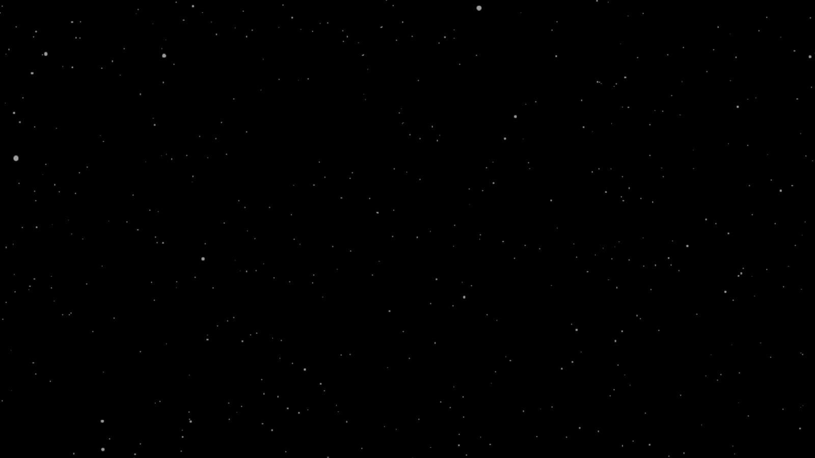


TEAM COSMOS
ASTROCARTUS
See the Solar System Move Before Your Eyes.

Slide 2
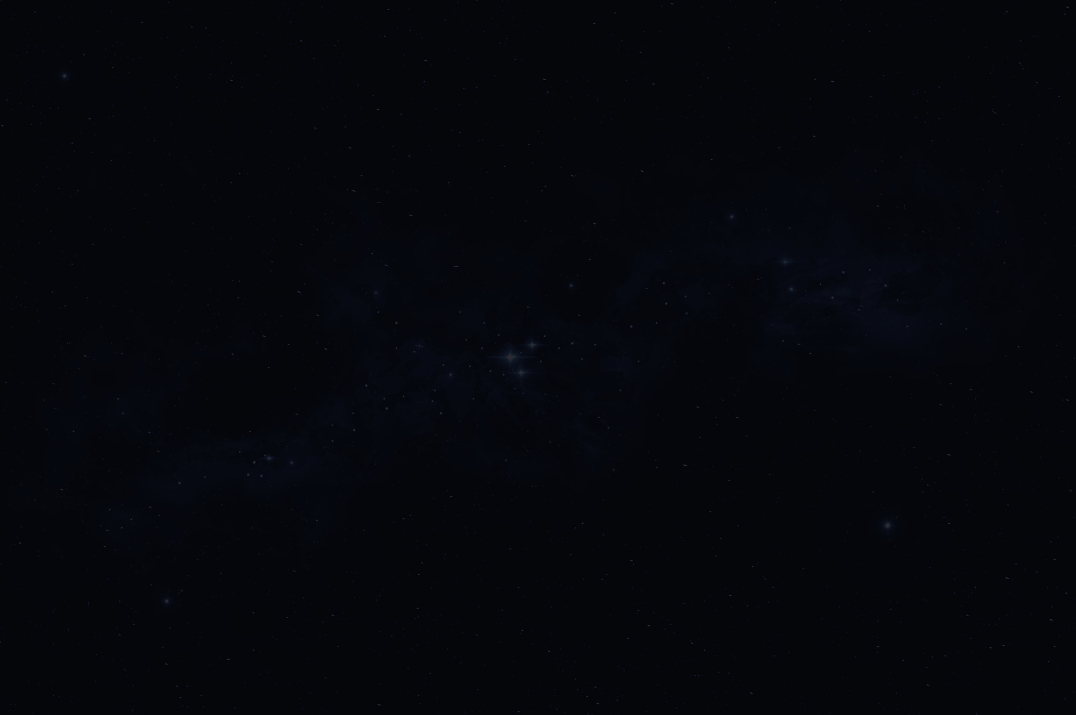
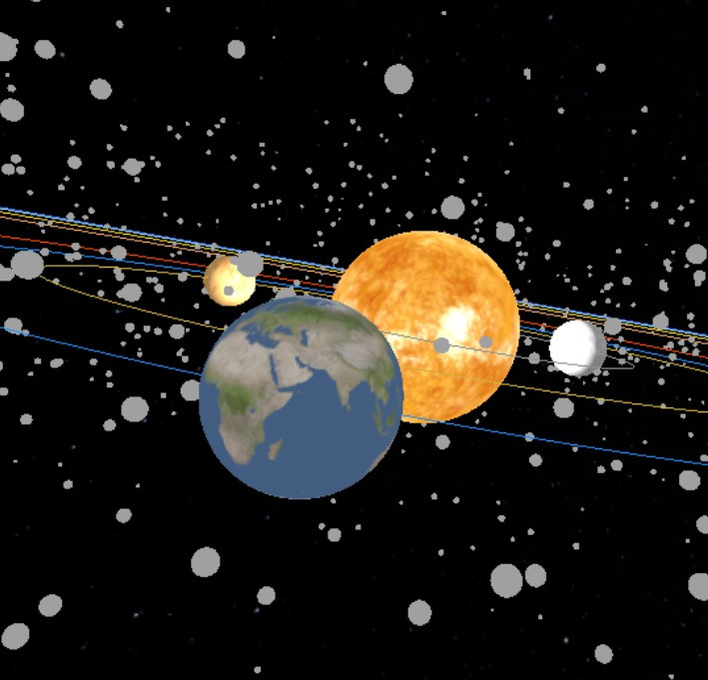
TEAM COSMOS
WELCOME TO OUR PRESENTATION
CONTENTS
ABOUT ASTROCARTUS
ABOUT OUR GALAXY
OUR VISION
CONTACT US
RESOURCES

Slide 3
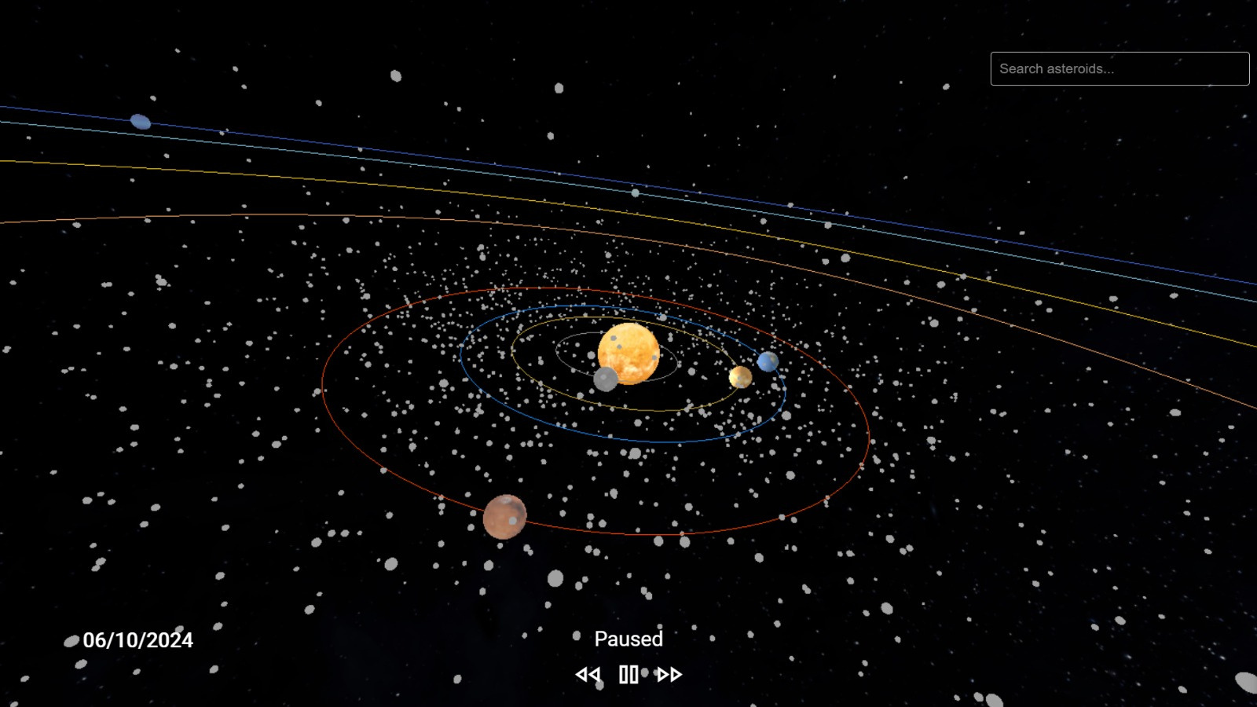
TEAM COSMOS
ABOUT ASTROCARTUS
Astrocartus is an innovative web platform that allows you to explore the mesmerizing movements of planets and asteroids. With our user-friendly interface, you can observe the dynamics of the universe from the past to the future.
Astrocartus enables you to track the real-time movements of planetLearn about each planet and asteroid as you gather informative content. Astrocartus makes learning enjoyable and engaging.s and asteroids. Visualize the orbits of each celestial body in detail. Accelerate time to observe the past and future movements of planets. This feature enhances your understanding of the dynamic nature of the universe.
A valuable resource for students and teachers in astronomy lessons.
A research tool for scientists and astronomers.
A fun discovery platform for space enthusiasts.

Slide 4
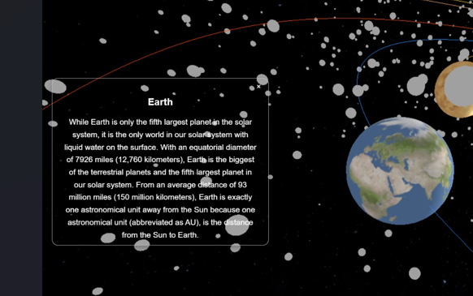
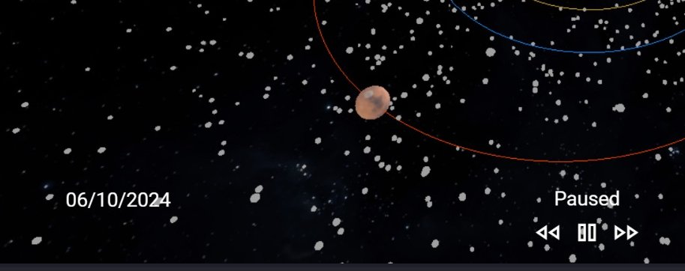
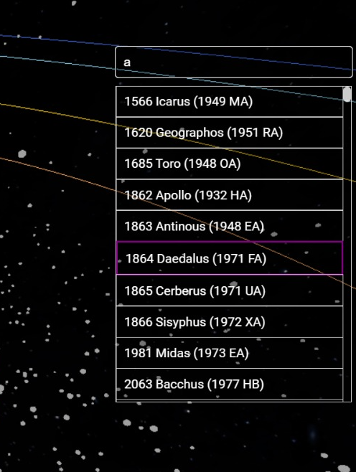
TEAM COSMOS
ABOUT OUR GALAXY
When users click on a planet, a pop-up will appear providing detailed information about that planet. This feature enhances the interactive experience by allowing users to explore the unique characteristics, history, and facts of each celestial body.
Our platform offers a time acceleration and deceleration feature, allowing users to observe the movements of planets and asteroids across different time scales. As time changes, the exact date of the simulation is displayed, enabling users to track planetary alignments and movements in real-time or across history.
With our search engine feature, users have the opportunity to explore data from 1,701 asteroids. This functionality allows for in-depth analysis and easy access to detailed information about each asteroid, enhancing the user’s ability to understand and engage with the vast data set.
01
02
03

Slide 5
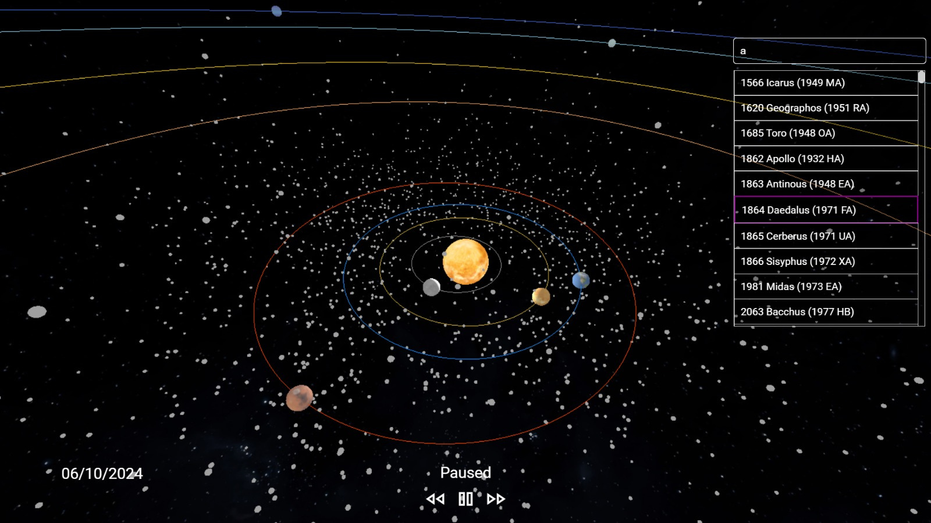
TEAM COSMOS
OUR VISION
At Astrocartus, our vision is to make the wonders of the universe accessible to everyone, inspiring curiosity and learning through the exploration of celestial bodies. We aim to bridge the gap between technology and astronomy by creating an interactive, educational, and engaging platform that empowers users to explore the cosmos in real-time.
01
We believe that understanding the universe should not be limited to scientists and astronomers—it should be an exciting journey for everyone. Our goal is to foster a deeper appreciation for the intricate mechanics of space and to ignite a passion for discovery, whether for students, researchers, or space enthusiasts.
02
Astrocartus envisions a future where space exploration is more interactive, immersive, and widely understood, encouraging the next generation of thinkers, dreamers, and explorers to look beyond the stars.
03

Slide 6
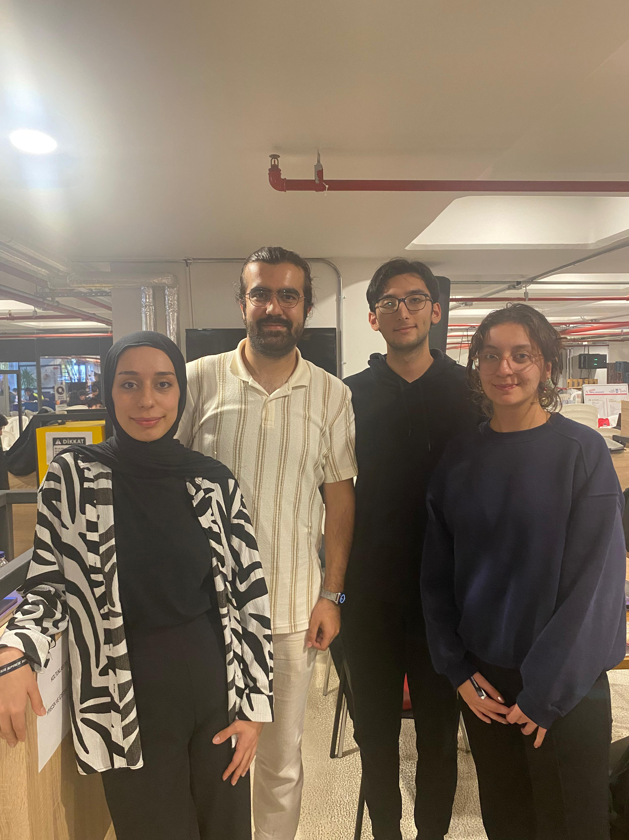


TEAM COSMOS
CONTACT US
BAHAR ARIN
baharin
baharinn
BEYZANUR GÜZEL
beyzanur-güzel
beyzanurrguzel
FURKAN FIRAT BOZKURT
furkanfiratbozkurt
mredos
KEREM ÜZER
kerem-uzer
keremuzer

Slide 7
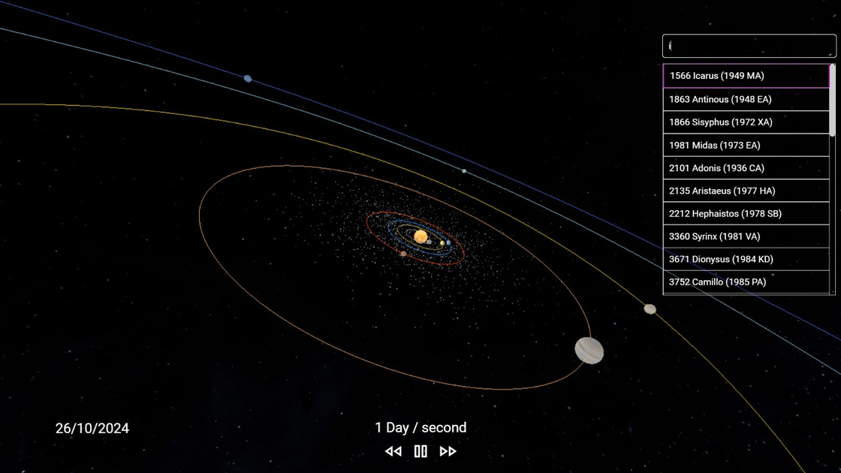
TEAM COSMOS
RESOURCES
https://threejs.org/docs/
https://ssd.jpl.nasa.gov/tools/sbdb_query.html
https://ssd.jpl.nasa.gov/planets/approx_pos.html#tables
https://www.solarsystemscope.com/textures/
https://github.com/nasa/mission-viz/blob/main/OntologyDrivenOrrery/OrbitalPropagator.js
https://github.com/keremuzer/AstroCartus

